Slide 1
Quick Reaction Game
Using Raspberry Pi

Slide 2
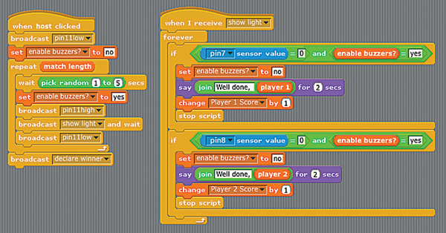
Flowchart

Slide 3
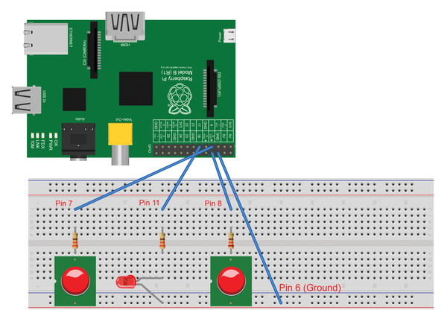
Project View

